Slide 1
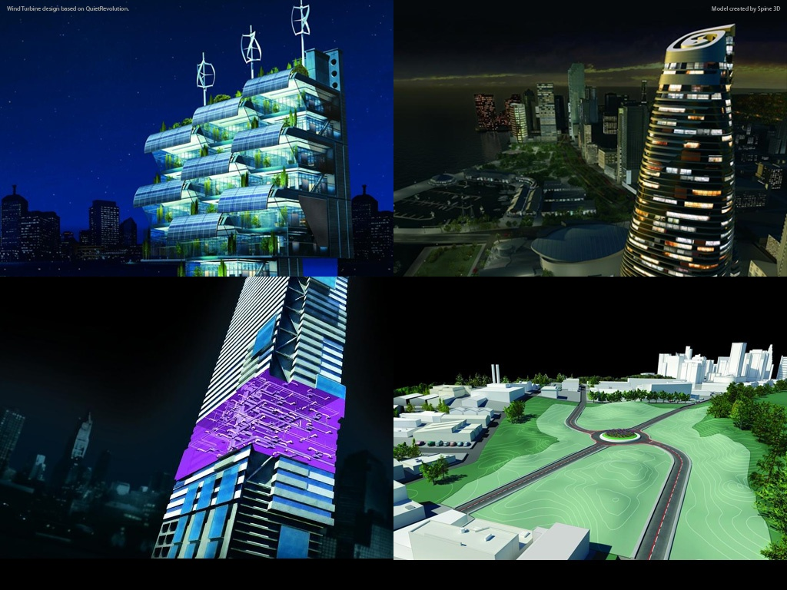
Bridge Design in AutoCAD Civil 3D
Tony Huang, Abraham Xu, Charles Zuo
SWD
Civil 3D
Notes:
Hello everyone, this is Tony Huang. I will introduce a proposed work flow of designing bridge in Civil3D. It’s a report from the bridge research group. The group includes me, Abraham and Charles.

Slide 2
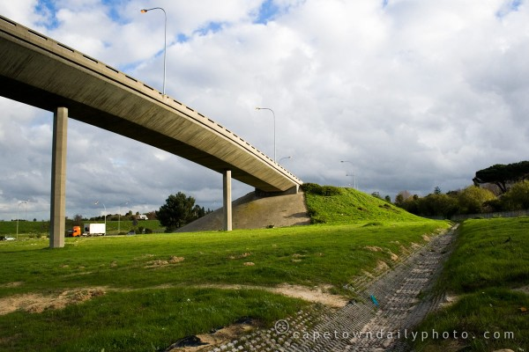
Agenda
Bridge types & scope
How to design a bridge
What can Civil 3D do in the bridge designing
Overview
Notes:
This is the agenda. The focus of this topic will be what Civil3D can do in the bridge designing.

Slide 3
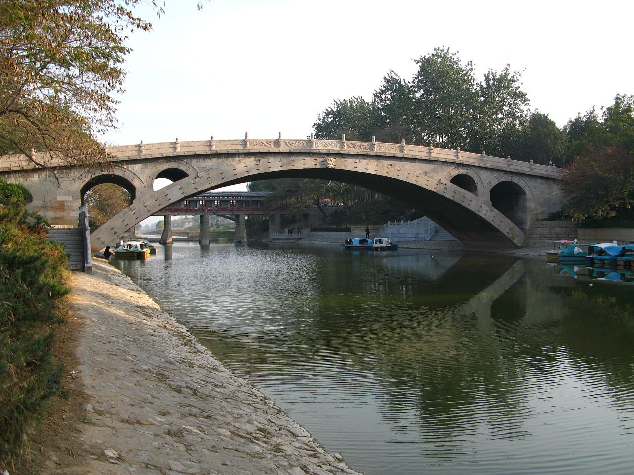
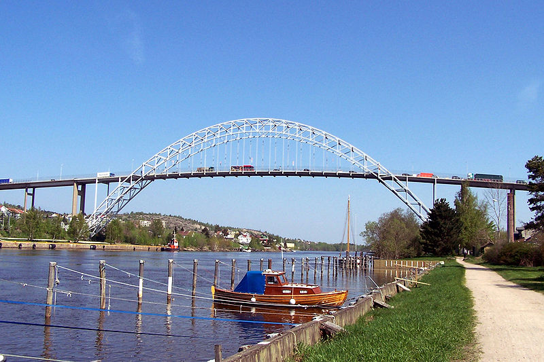
Bridge Types
Arch Bridge
Suspension Bridge
Cable-stayed Bridge
Continuous Truss Bridge
Notes:
First of all I will introduce the bridge types. This is the arch bridge. This kind is named from the arch.
An arch bridge is a bridge with abutments at each end shaped as a curved arch. Arch bridges work by transferring the weight of the bridge and its loads partially into a horizontal thrust restrained by the abutments at either side.
Zhaozhou Bridge, Fredrikstad Bridge Norway腓特烈斯塔（挪威东南部海港）

Slide 4
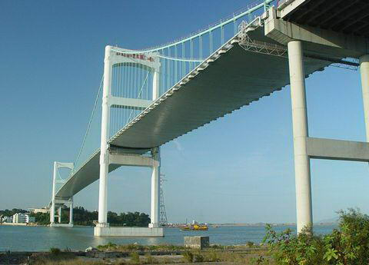
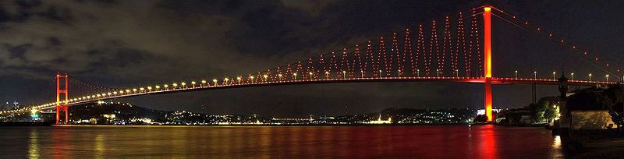
Bridge Types
Arch Bridge
Suspension Bridge
Cable-stayed Bridge
Continuous Truss Bridge
Notes:
This is the suspension bridge. There are some vertical cables.
A suspension bridge is a type of bridge in which the deck (the load-bearing portion) is hung below suspension cables on vertical suspenders.
Shantou Bridge, Bosphorus Bridge in Istanbul博斯普鲁斯大桥(伊斯坦布尔)

Slide 5
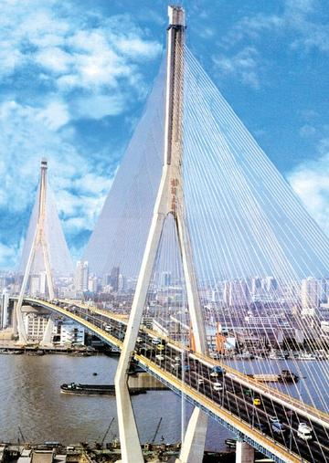
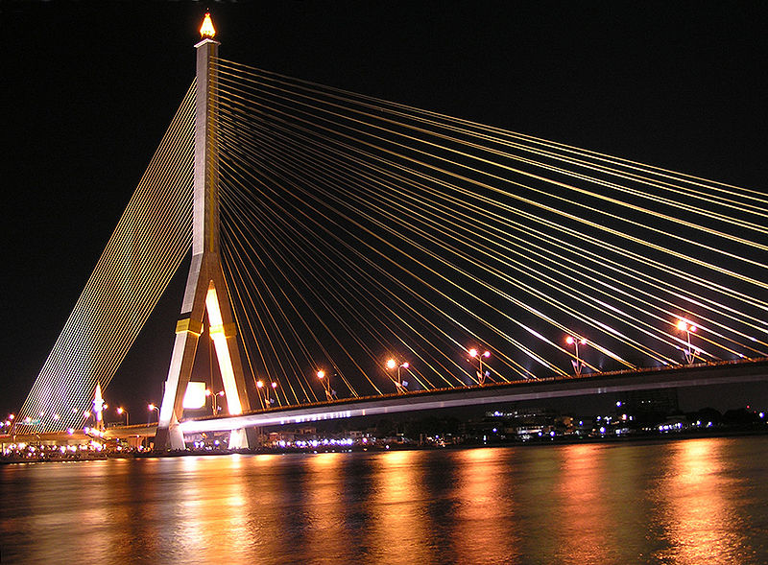
Bridge Types
Arch Bridge
Suspension Bridge
Cable-stayed Bridge
Continuous Truss Bridge
Notes:
This is the cable-stayed bridge. There are one or more towers and some slope cables.
A cable-stayed bridge is a bridge that consists of one or more towers, with cables supporting the bridge deck.
Yangpu Bridge, Rama VIII Bridge (罗摩8)

Slide 6
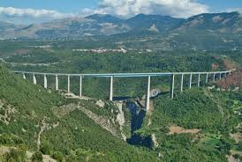
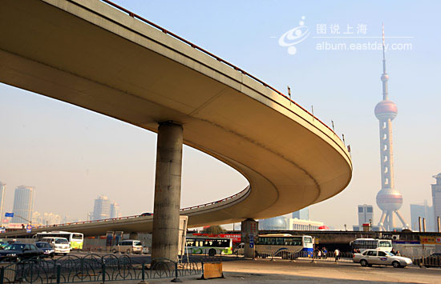
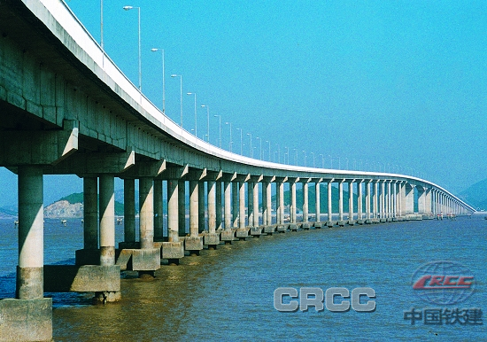
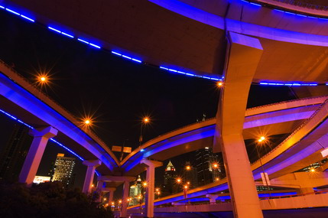
Bridge Types & Scope
Arch Bridge
Suspension Bridge
Cable-stayed Bridge
Continuous Truss Bridge
------ Scope
Notes:
Truss and Continuous Truss Bridge
This type of bridges likes a bench. It doesn’t have arch curves, has no big towers or cables. All of the loads are through the supports transfer to the ground.
To design a continuous truss bridge is our scope.

Slide 7
How to design a bridge
Notes:
Conceptual design, both model type and structure type of bridge will be selected.
And then the engineer will do some structure analysis, and detailed design, and redesign. Sometime the final design comes out with several iterations.
Make the construction process management plan.
Submit the drawings and the project reports.

Slide 8
Proposed Work Flow in Civil 3D
Civil3D
Modeling
Structure
Analysis
(RSA)
(RST)
(ASD)
Alignment
Design conditions
Profile
Gravity load
Wind load
Shock
Brake load
Assembly
Mechanics
SAC
Bridge
Section
Compressive
Road
Section
Bending
Shearing
Work Flow Demo
Corridor
Material
Intersection
Steel
Foundation design
Reinforced concrete
...
Supports
...
PresTrussed concrete
...
Foundation
...
Drawings & Reports
Notes:
This is the proposed work flow of designing bridge. It is similar to designing a road. In the left picture, the yellow parts are newly added, as Bridge section, Supports, Foundation and Piles. And these three parts are needed to do structure analysis. And we also should improve the function of corridor and intersection. I will talk about them detail in the following pages.

Slide 9
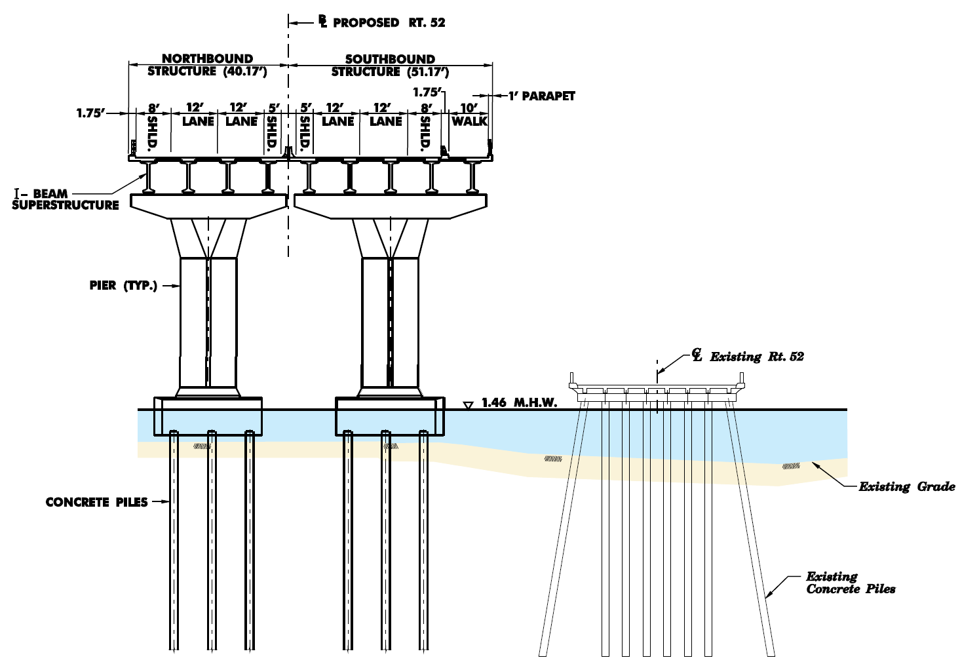
Modeling
Notes:
All the models are complete. In this picture, the I-Beam, the slab and the road section are continuous. The supports, the foundation and the piles are independence.

Slide 10
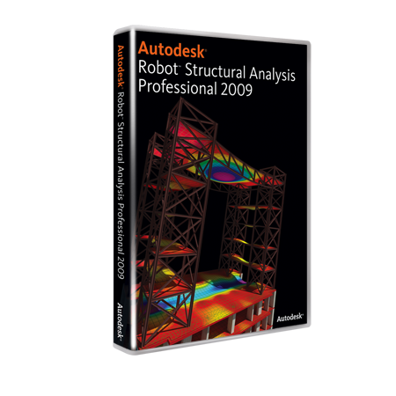
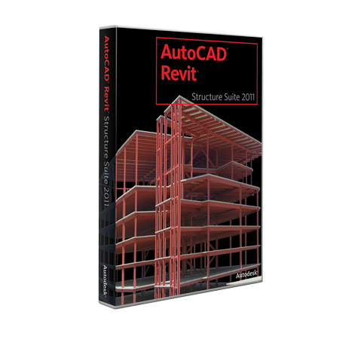
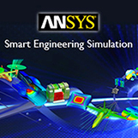

Structure
Analysis
Notes:
When design the bridge section, the supports and the foundations, the engineer will do some structure analysis with the 3D model.
If necessary, we can provide the interface, and output the 3d model of the bridge. So that some other Finite Element Analysis software (as ANSYS, ADINA) and other bridge software (as Midas Bridge, Lucas) can use the model to do the structure analysis.

Slide 11
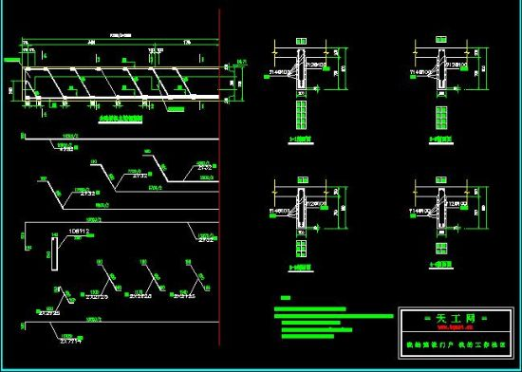
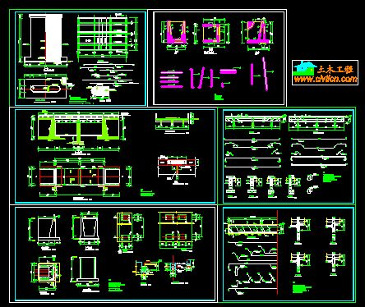
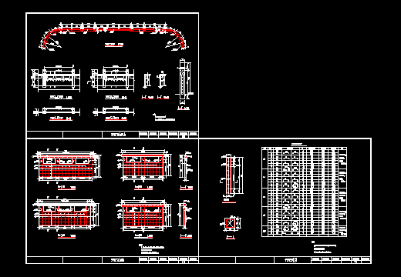
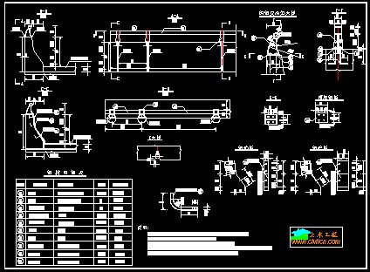
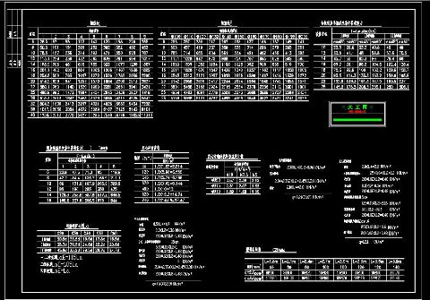
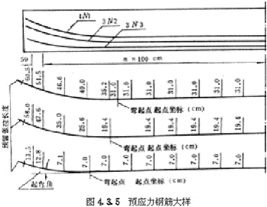
Drawings
Reports
Notes:
And then designer can use Civil3D to output the drawings and Reports.

Slide 12
Overview
Bridge
Section
Supports
Foundation
Corridor
Intersection
Continuous Truss Bridge
Arch Bridge
Suspension Bridge
Cable-stayed Bridge
Notes:
These three parts are newly added, Bridge section, Supports, Foundations. And we need to improve the Corridor and Intersection.
After that we can model the Truss bridge in Civil 3D. If add more structure types, we can model all of the bridge types.

Slide 13
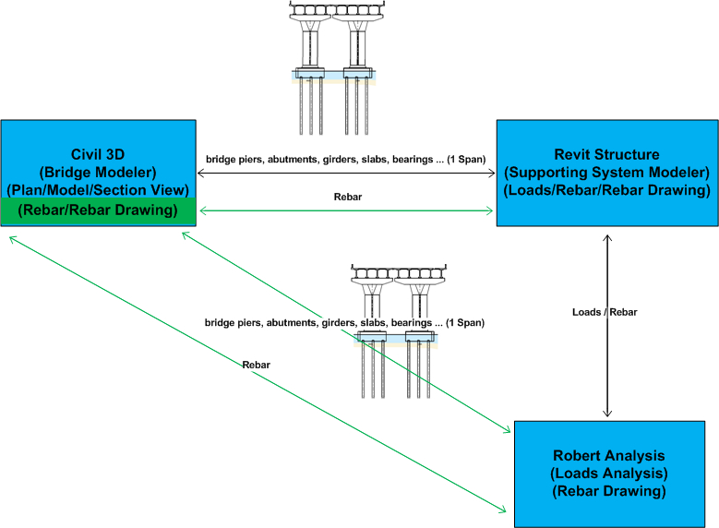
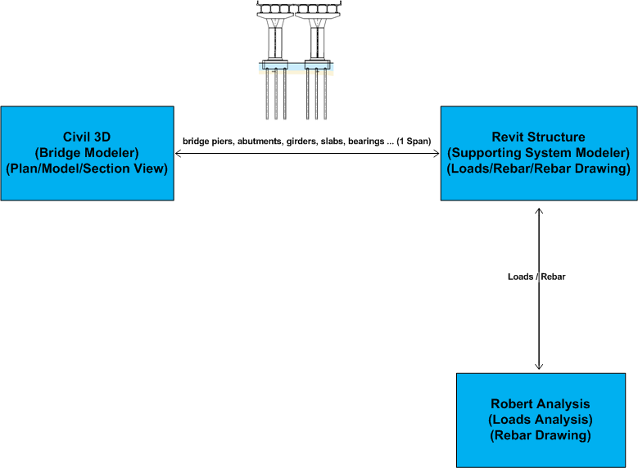
Product Portfolio

Slide 14
Q & A

